Slide 1














Project Presentation
Presented by Siri Chandhana
Reg num : 12310028
----Django Login System
A python based Login System-----

Slide 2



Let’s Get Started
Introduction
Objective & Scope Of the Project
Application Tools
Project Design
Flowchart
Project implementation
Testing And Validation
Conclusion
References

Slide 3

Introduction
The Django-based login system in Python is an all-encompassing security framework for user authentication and account management. It employs the built-in authentication system of Django, thereby making user registration, login, logout, and password management as easy as possible. Some of the important features of this system include role-based access control for resource management security and email verification in the registration process for security enhancement. Furthermore, the system enables third-party login integration such as Google and Facebook login. A responsive front-end design combined with backend functionality makes the authentication processes user-friendly and extensible, yet compliant with high-security standards, and an excellent foundation for modern web applications.

Slide 4
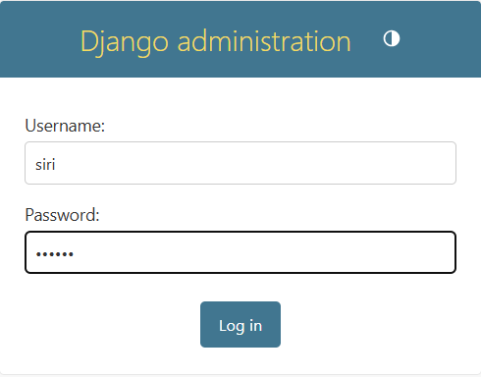
Objectives Of the Project
1. Implement Secure Authentication: Enable secure user login and registration, including password hashing and validation, to ensure the safety of user credentials.
2. Provide Role-Based Access Control: Support different user roles with customized access to features and resources, enabling precise control over the system’s functionality..
3. Enhance Usability: Deliver a simple, intuitive user interface for logging in, registering, and managing accounts, ensuring ease of use for all users.
4. Facilitate Account Management: Offer features like password resets, email verification, and profile updates, providing users with control over their accounts
5. Promote Efficient Workflow: Streamline authentication and user management processes, reducing administrative overhead and improving overall productivity.

Slide 5
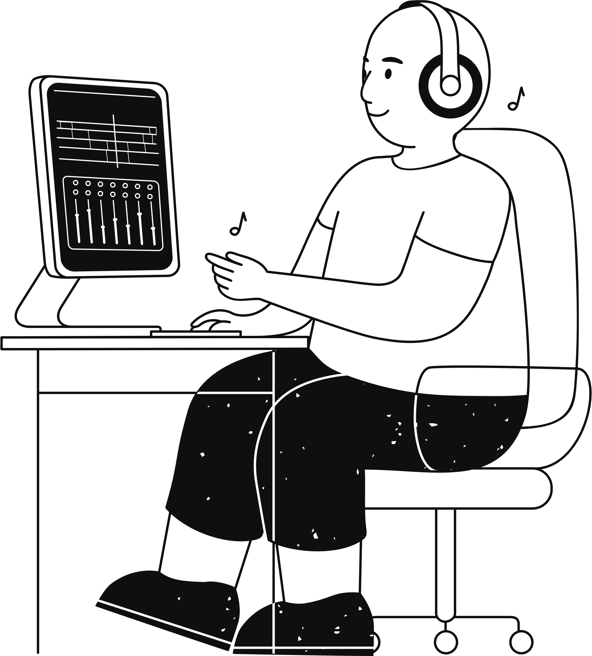
Scope Of the Project
Scope of the Project
1.Secure Authentication: Guarantees secure and dependable login, registration, and password management for users
2.Role-Based Access: Instructs permissions based on access restrictions due to the roles the users assume.
3.Scalability: Adaptable for integration into various platforms like e-commerce, educational portals, and enterprise systems.
4.User-friendly experience: It gives fluid interaction and a responsive interface where it could be accessed by hand for authentication management.
5. Enhanced Security: Third-party login support along with email verification will be integrated for user protection login.
6. Modular Design: Facilitates easy updates, new feature integration, and future expansion for evolving requirements.

Slide 6





1.Core Tools
•Python
:Main programming language for its simplicity and versatility.
•Django Framework: Provides a secure and efficient foundation for web development.
3. System & Web Integration
Django REST Framework: Supports API development for external services.
HTML: Builds a responsive, interactive frontend.
SMTP/SendGrid: Facilitates email verification.
,
Application
Tools
2. Development Environment
•VS Code: For streamlined development and debugging.
•Postman: To test API endpoints for email verification and integrations..
•Notepad++: For drafting code snippets and pseudo-code.
4. Additional Tools
•Git: Tracks code changes and enables version control.
•Browsers
(Edge/Chrome): Used for testing and debbugging.

Slide 7
Project Design
1.Input Layer:
•Captures user input through web forms for registration, login, and password management.
•Validates user credentials using Django’s built-in authentication system.
2.Processing Layer:
•Handles user registration, password resets, and email verification using Django-Allauth
•Implements role-based access control to ensure users access only permitted resources.
3.Action Layer:
•Executes system commands (e.g., account creation,Authentication).
•Manages user roles and permissions for secure access (e.g., admin access).
4.Output Layer:
•Provides feedback to users through success or error messages on the frontend.
•Uses HTML for rendering responsive, user-friendly login, registration, and profile pages.
5.System Integration:
•Communicates with external email services (SMTP/SendGrid) for account verification and password recovery.

Slide 8
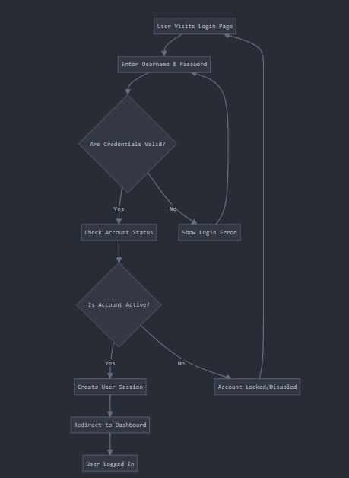
FlowChart
flowchart for the Virtual Assistant Python code
•Start: User login page
•Input (Username & Password): User enters login credentials.
• Process Credentials: System validates user credentials.
• Decision (Credentials Valid?): Checks if login information is correct.
If Yes: Verify account status .Check if account is active
If No: Display login error message. Prompt user to retry login

Slide 9
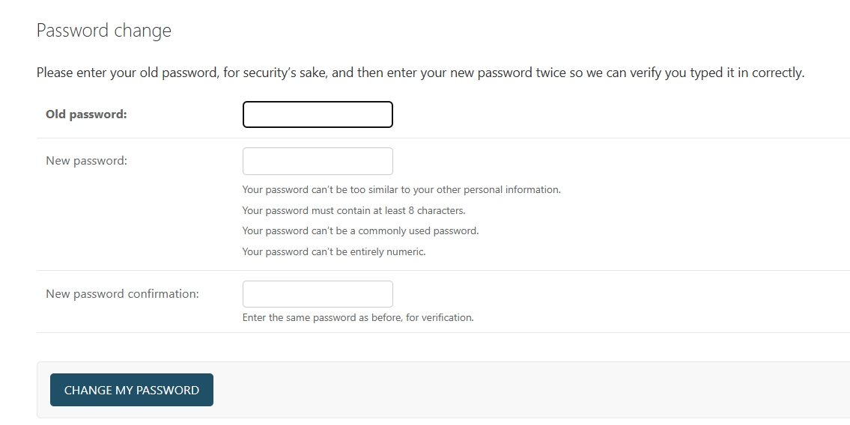
Project Implementation
r
1.Environment Setup:
Install Python and set up Django framework along with required libraries (Django-Allauth)
2.User Authentication Module: Implement Django's authentication system for user login, registration, and password management.
3.Response Handlimg : Implement logic for user feedback through success/error messages during login, registration, and password reset.
4.Task Automation: Automate user account actions like registration, password resets, and session management.
5.Testing & Debugging:Test individual features, debug errors, and validate performance.
6.Final Deployment: Ensure scalability, security, and smooth execution for real-world usage..
Level Design
Challenge:
Creating multiple levels with increasing difficulty while maintaining variety and interest.
Loading level data dynamically and ensuring seamless transitions.
Solution:
Used CSV files to design and load levels dynamically, making it easier to create new levels.

Slide 10
Testing & Validation
User Authentication
Functionality and Execution
Response Accuracy
Error Handling
Performace Testing
Validated the accuracy of Django's authentication system in verifying user credentials and ensuring proper login.
Key Areas Tested:
Validating user credentials and preventing unauthorized access.
Verified the system's ability to execute tasks such as user registration, login, password reset, and email verification.
Key Areas Tested: Successful registration, login/logout execution.
Ensured the system responds correctly to user actions (login, registration, password reset).
Key Areas Tested:
Real-time accuracy in updating user sessions and redirecting after successful login or registration
Validated the system’s ability to handle errors such as invalid login attempts, incorrect password entries, and failed email verifications.
Key Areas Tested:
Handling and displaying appropriate error messages.
Tested the system's efficiency, ensuring smooth performance under different load conditions..
Key Areas Tested: Response time during login, registration, and password reset.

Slide 11

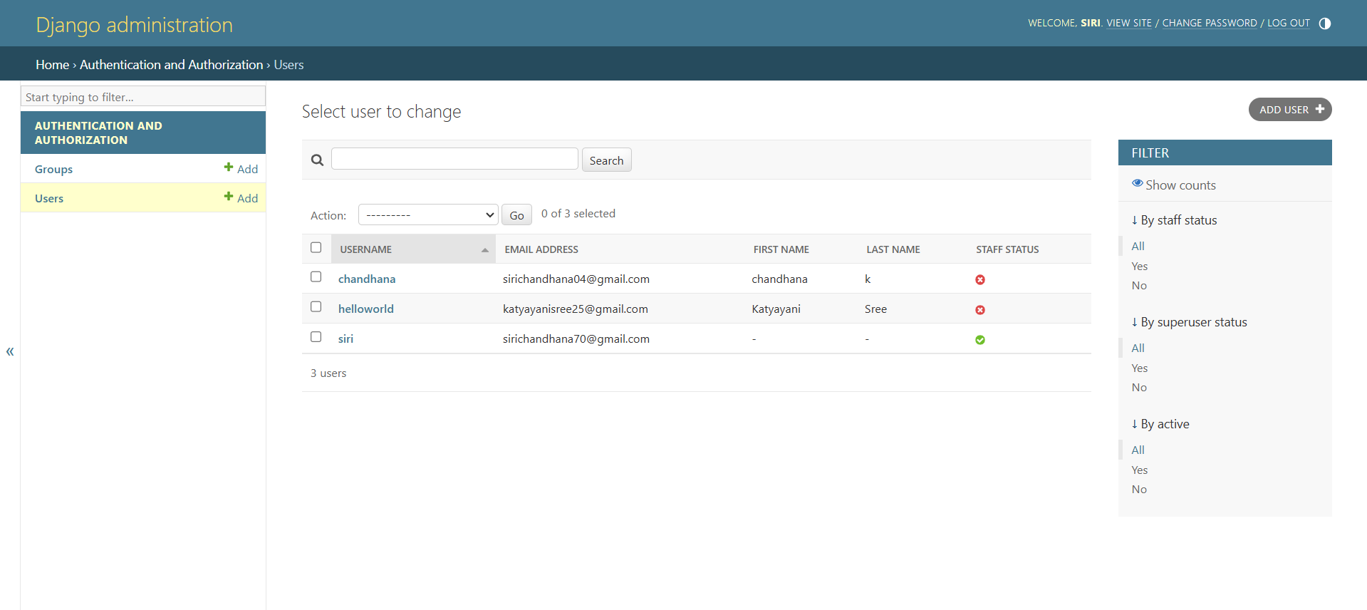
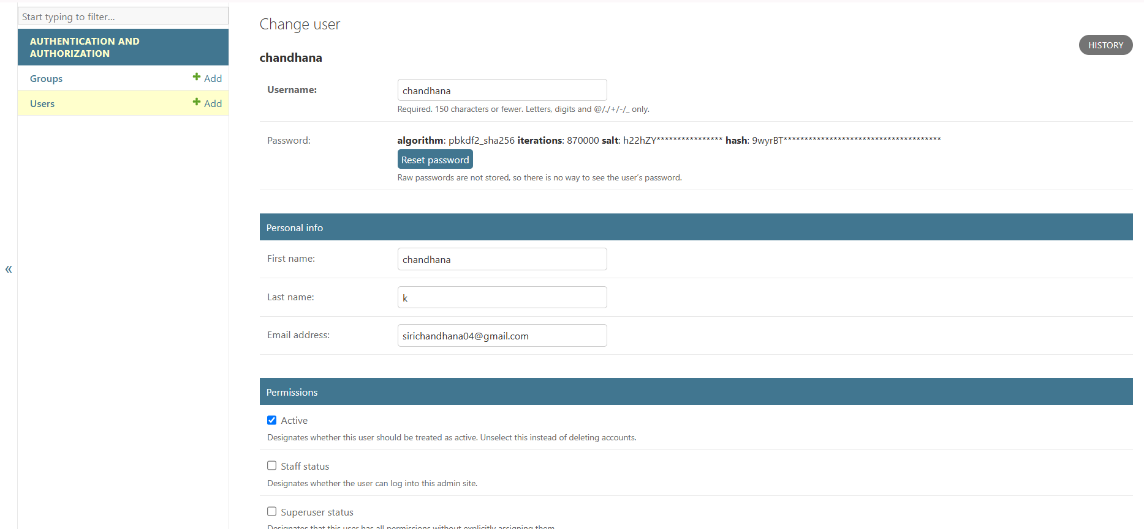


Output
screenshots:

Slide 12
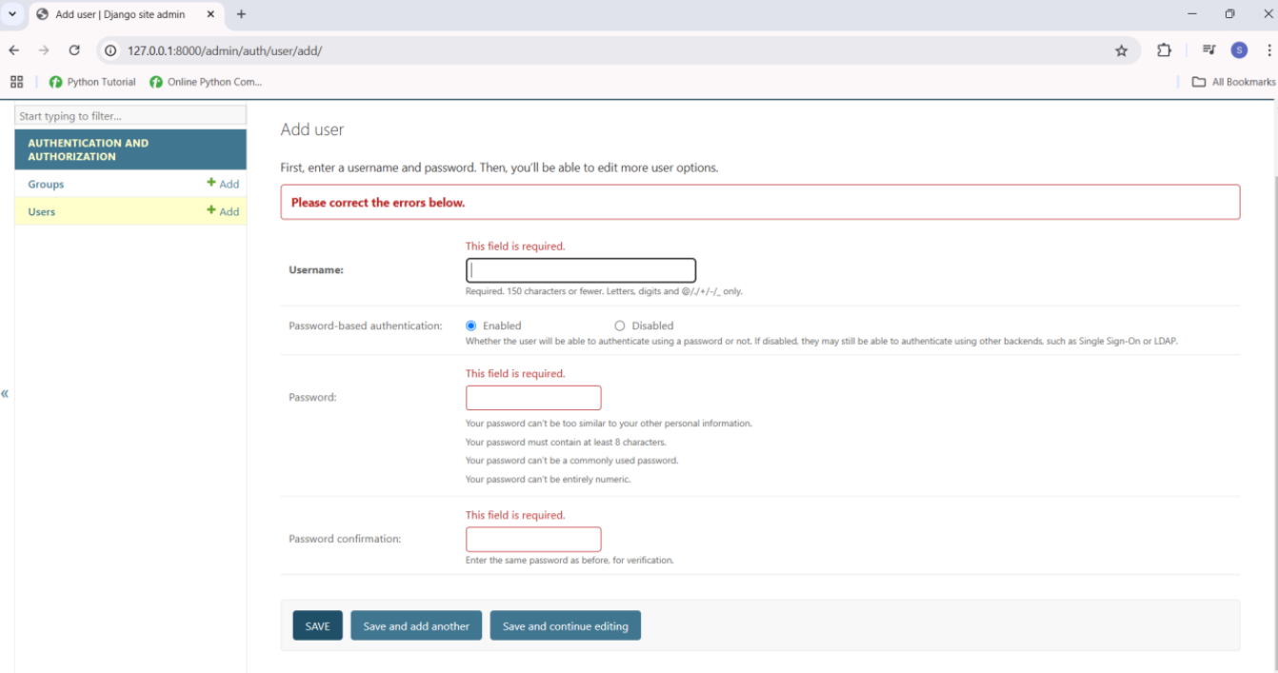
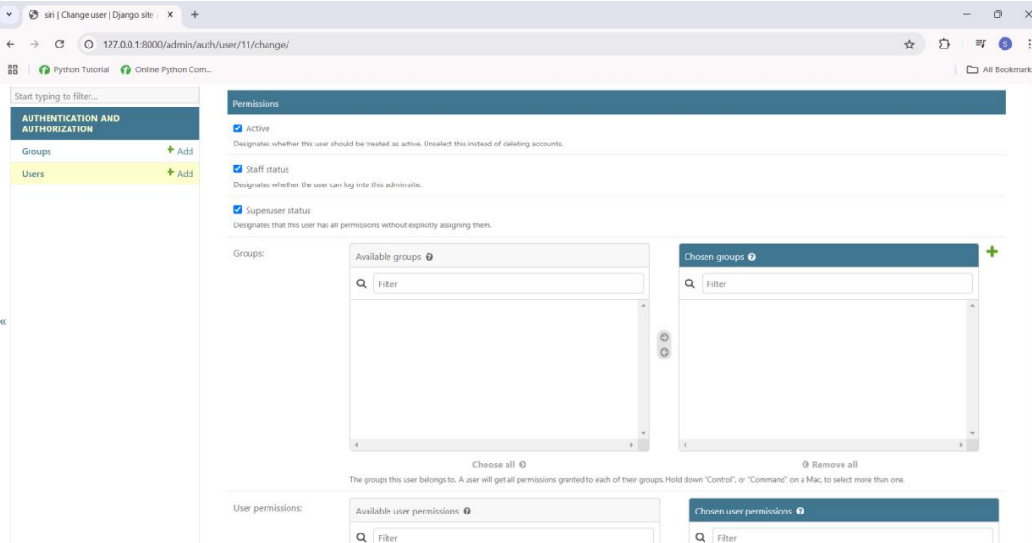


Slide 13

Conclusion
The Django-Based Python Login System project demonstrates the effective integration of secure user authentication and management functionalities. Built using Python and Django, it provides a robust, scalable platform for managing user registration, login, password resets, and role-based access control. The system’s flexibility and security make it an essential tool for web applications requiring user account management, ensuring seamless and protected user experiences. By simplifying routine authentication tasks and offering extensibility for third-party logins, it showcases a step forward in developing secure, user-centric web applications.

Slide 14
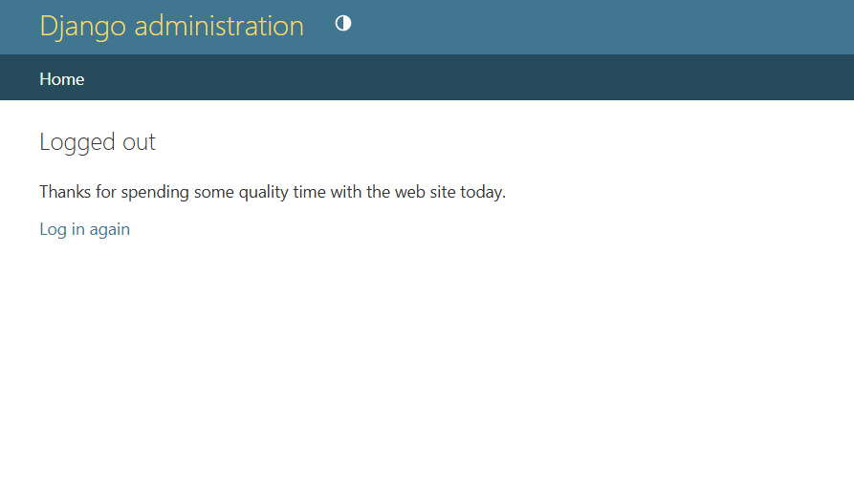
References
References for Python GUI Assistant
1.Django documentation:
https://docs.djangoproject.com/en/5.1/ Official guide for building web applications with Django.
2. Django-Allauth Documentation: Essential for user authentication.
https://django-allauth.readthedocs.io/en/latest/
3. Django REST Framework:
For creating RESTful APIs, enabling integrations with external applications.
https://www.django-rest-framework.org/
4. Django Security Best Practices:
Insights into securing your Django application and protecting user data.
https://docs.djangoproject.com/en/5.1/topics/security/
Books:
"Django for Beginners" by William S. Vincent
"Two Scoops of Django" by Audrey Roy Greenfeld and Daniel Roy Greenfeld
"Python Crash Course" by Eric Matthes

Slide 15
Thank you !

